Slide 1

Overview Brownfield Assessments and Cleanup
DataDive March 2021

Slide 2
Brownfields are…
“real property, the expansion, redevelopment or reuse of which may be complicated by the presence or potential presence of a hazardous substance, pollutant or contaminant”
Comprehensive Environmental Response, Compensation, and Liability Act of 1980, as amended by the Small Business Liability Relief and Brownfields Revitalization Act of 2002, §101(39)

Slide 3
Why is it important to clean up brownfield sites?
Community Benefits
Cleaning up brownfield sites, many of which have been vacant for some time, may reduce blight and crime in a neighborhood.
Depending on the intent of the redevelopment, a community may regain greenspaces.
Environmental Benefits
When brownfield sites are cleaned up for reuse, new sites do not need to be developed. This improves water quality associated with reduced stormwater runoff (compared to new impervious surfaces).
Since brownfields are often located in or near metropolitan areas, residents near redeveloped sites don’t need to drive as far for personal or employment purposes. This helps with greenhouse gas emissions.
Economic Benefits
Employment for brownfield assessors and cleanup crews.
Potential for property value increases in nearby areas.
Redeveloped sites may be turned into opportunities for new jobs or residences.

Slide 4
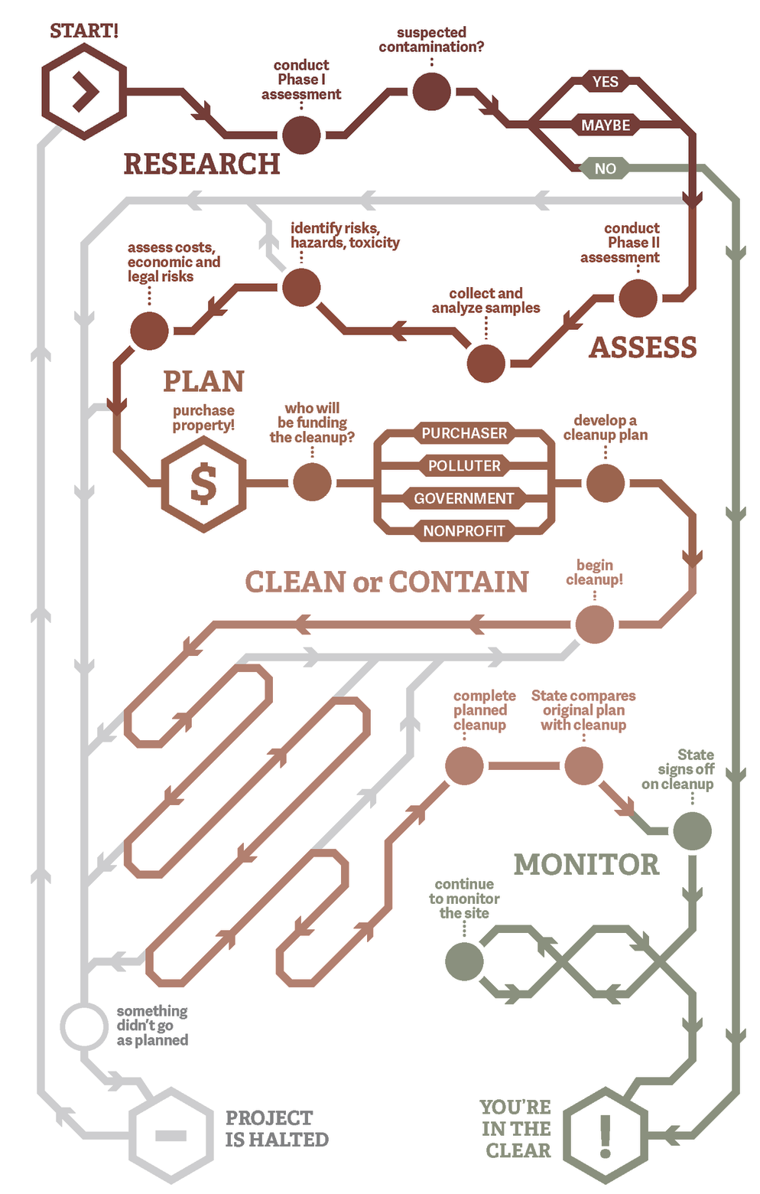
Process for brownfield assessment and cleanup.
Phase 1 Assessment
Go through state/tribal/local records to see if the site might be contaminated. This phase is usually conducted before you purchase a property. If nothing is found here, no Phase 2 Assessment or Cleanup is needed.
Phase 2 Assessment
Conduct soil sampling, water sampling, etc. to explore findings from Phase 1. This will give you direction for your cleanup.
Cleanup
Address issues found in the Phase 2 Assessment.
Adapted from The Rundown: A Recipe for Brownfield Cleanup

Slide 5
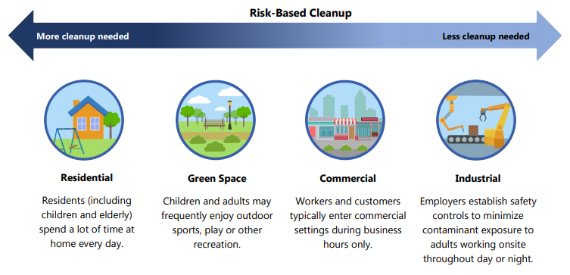
Cleanup of brownfield sites depends on planned reuse and risk to future occupants.
More cleanup required
Industrial Employers establish safety controls to minimize contaminant exposure to adults working onsite throughout day or night | Commercial Workers and customers typically enter commercial settings during business hours only. | Green Space Children and adults may frequently enjoy outdoor sports, play or other recreation. | Residential Residents (including children and elderly) spend a lot of time at home every day.
Adapted from Cleaning up Brownfield Sites

Slide 6
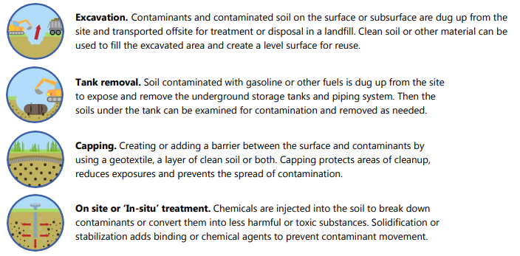
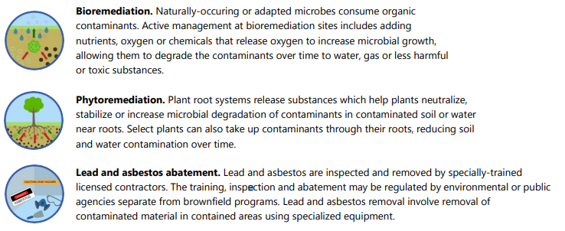
Brownfield site cleanup activities.
Excavation. Contaminants and contaminated soil on the surface or subsurface are dug up from the site and transported offsite for treatment or disposal in a landfill. Clean soil or other material can be used to fill the excavated area and create a level surface for reuse.
Tank removal. Soil contaminated with gasoline or other fuels is dug up from the site to expose and remove the underground storage tanks and piping system. Then the soils under the tank can be examined for contamination and removed as needed.
Capping. Creating or adding a barrier between the surface and contaminants by using a geotextile, a layer of clean soil or both. Capping protects areas of cleanup, reduces exposures and prevents the spread of contamination.
On site or ‘In-situ’ treatment. Chemicals are injected into the soil to break down contaminants or convert them into less harmful or toxic substances. Solidification or stabilization adds binding or chemical agents to prevent contaminant movement.
Bioremediation. Naturally-occurring or adapted microbes consume organic contaminants. Active management at bioremediation sites includes adding nutrients, oxygen or chemicals that release oxygen to increase microbial growth, allowing them to degrade the contaminants over time to water, gas or less harmful or toxic substances.
Phytoremediation. Plant root systems release substances which help plants neutralize, stabilize or increase microbial degradation of contaminants in contaminated soil or water near roots. Select plants can also take up contaminants through their roots, reducing soil and water contamination over time.
Lead and asbestos abatement. Lead and asbestos are inspected and removed by specially-trained licensed contractors. The training, inspection and abatement may be regulated by environmental or public agencies separate from brownfield programs. Lead and asbestos removal involve removal of contaminated material in contained areas using specialized equipment.
Adapted from Cleaning up Brownfield Sites

Slide 7
Who pays for brownfield cleanup?
It varies. It can be the purchaser of the site, the polluter of the site, local or state governments, the federal government, or other public or private sources. Here are some examples of ways to fund cleanup:
Public-Private Partnership: Agreement between a public-sector entity and private-sector organization to combine resources.
In public-private partnerships for brownfield redevelopment, typically:
the public entity sponsors the project and provides some initial funding, often for environmental site assessments and for infrastructure to support development, and
a private-sector developer then funds and manages the pre-development and construction process.
Federal Government: EPA’s Brownfields Grants
Assessment, Revolving Loan Fund and Cleanup Grants
Area-Wide Planning Grants
Environmental Workforce Development and Job Training Grants
Training, Research, and Technical Assistance Grants
Adapted from Anatomy of Brownfields Redevelopment and Brownfields Road Map

Slide 8
For more information, visit these links.
Property uses that may result in a brownfield site.
Assessing brownfield sites.
Funding Resources
2015 Brownfields Federal Programs Guide
Setting the Stage for Leveraging Resources for Brownfields Revitalization
Organizations
Community Lattice
TAB Program

Slide 9
References
Anatomy of brownfields redevelopment. 2019. United Stated Environmental Protection Agency. https://www.epa.gov/sites/production/files/2015-09/documents/anat_bf_redev_101106.pdf
Brownfields program environmental and economic benefits. 2021. United Stated Environmental Protection Agency. https://www.epa.gov/brownfields/brownfields-program-environmental-and-economic-benefits
Brownfields road map to understanding options for site investigation and cleanup, sixth edition. 2018. United States Environmental Protection Agency. https://www.epa.gov/brownfields/brownfields-road-map
Cleaning up brownfield sites, EPA 560F19181. 2019. United States Environmental Protection Agency. https://www.epa.gov/sites/production/files/2019-10/documents/cleaning_up_brownfield_sites.pdf
The rundown: So you want to clean up a brownfield. Here’s how. 2017. Oregon Metro Council. https://www.oregonmetro.gov/news/rundown-so-you-want-clean-brownfield-heres-what-do
What’s the most important benefit of a brownfields redevelopment project? 2021. Environmental Standards. https://www.envstd.com/most-important-benefit-of-brownfields-redevelopment-project/

